Slide 1
Coding Workshop
Welcome!

Slide 2
Welcome!

Slide 3
Warm up time
Blow wind blow!

Slide 4
Say hello
To your new neighbors and our volunteers!

Slide 5
Kahoot game
Let’s have fun!

Slide 6
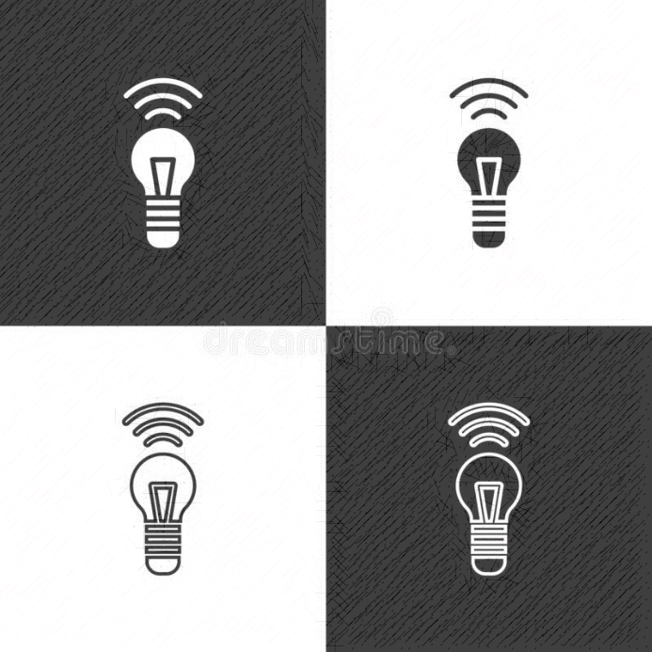
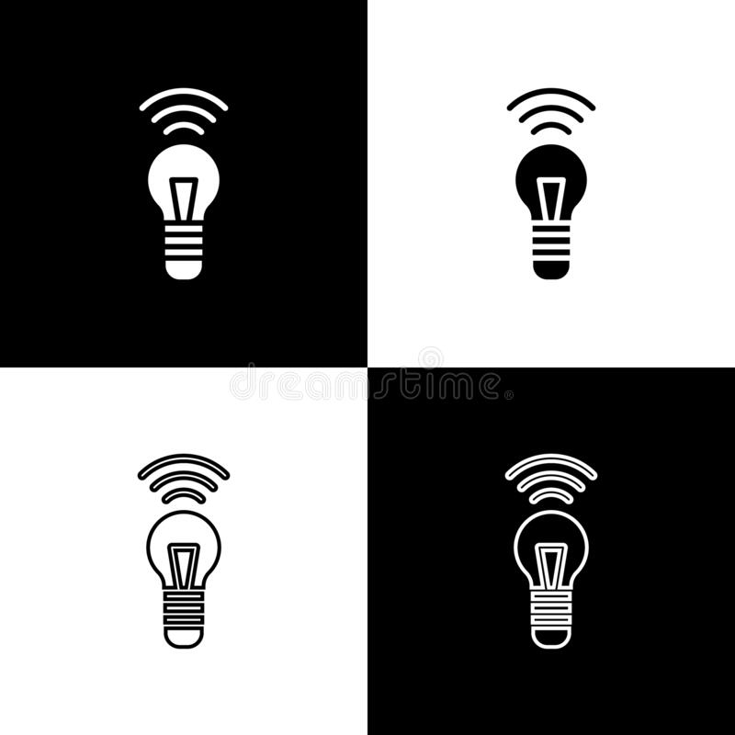
DIY SMART LIGHTING SYSTEM

Slide 7

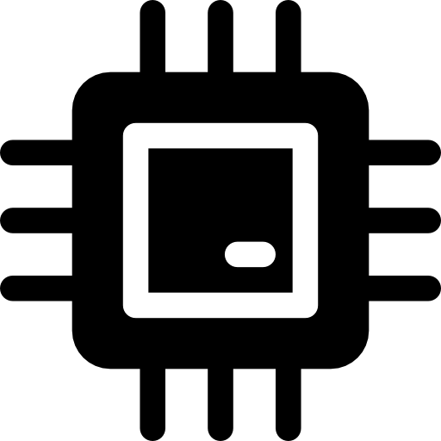

Sensor
RPi
Light

Slide 8
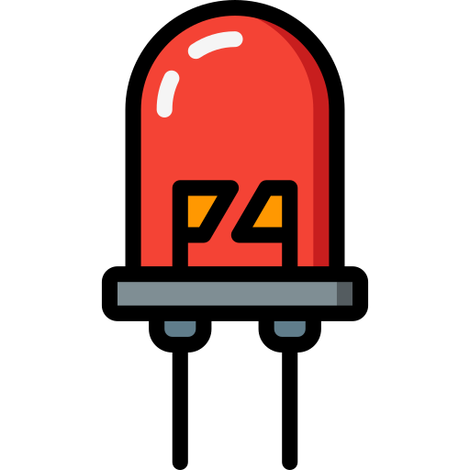
Sensor
RPi
Light

Slide 9
Program for today
Raspberry Pi & Circuit design
Run Python on Pi
Program the Smart Lighting System

Slide 10
HardWare Basics

Slide 11
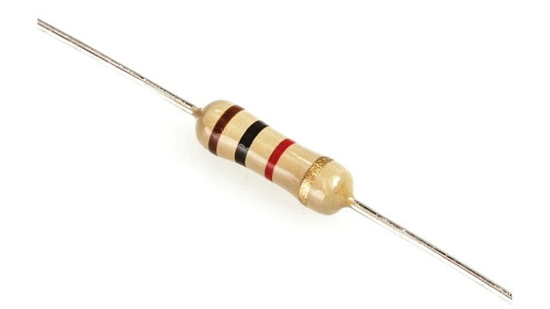
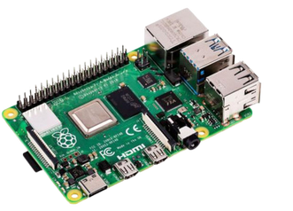
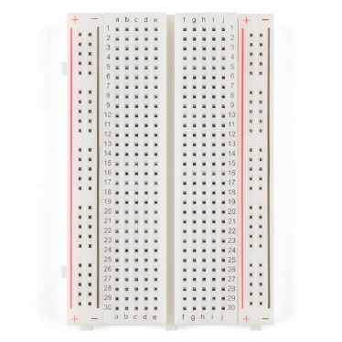
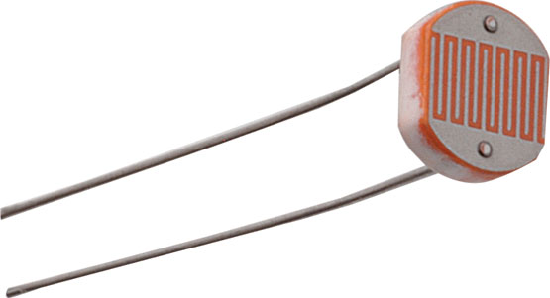
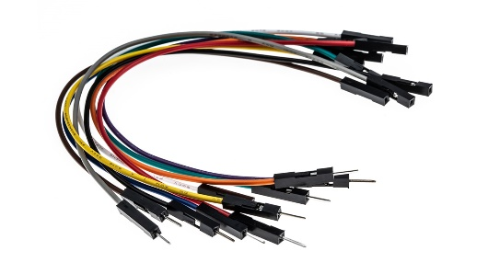
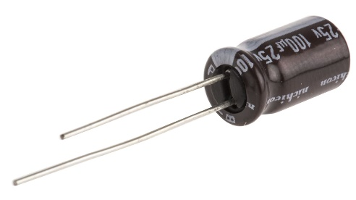
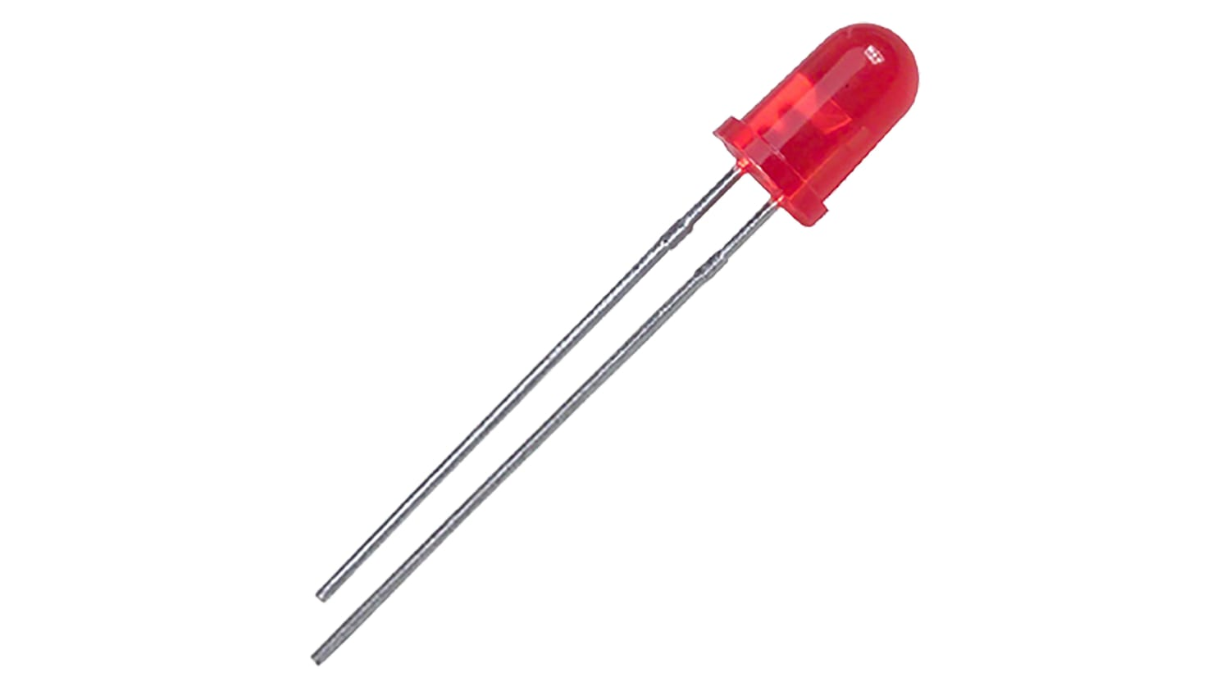
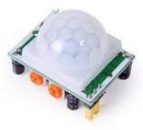
THE HARDWARE
Rasberry Pi (RPi)
Breadboard
Jumper Wires
Light-Emitting Diode (LED)
Resistor
Light Dependent Resistor (LDR)
Capacitor
Motion sensor (for bonus part)

Slide 12
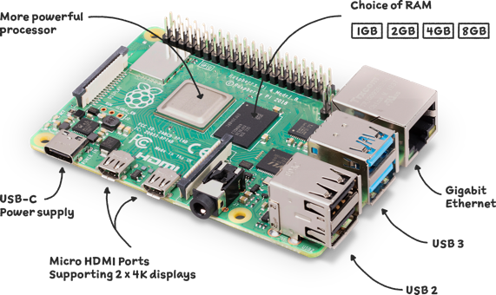
What is Raspberry Pi?
Notes:
https://www.raspberrypi.org/help/what-%20is-a-raspberry-pi/

Slide 13

GPIO PIN conventions
TBC

Slide 14
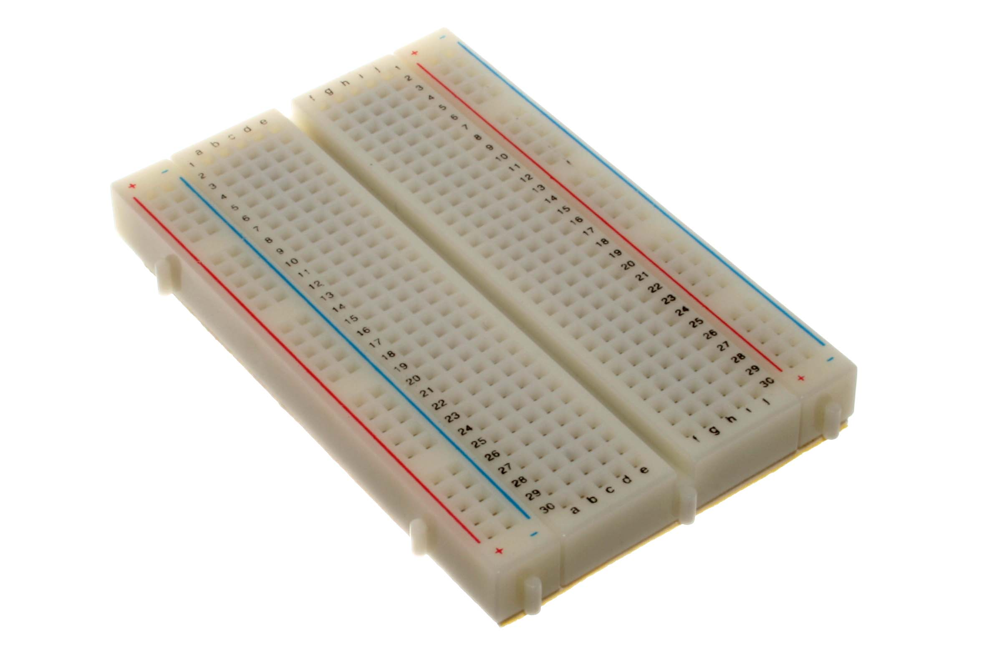
Solder-less Bread Board

Slide 15
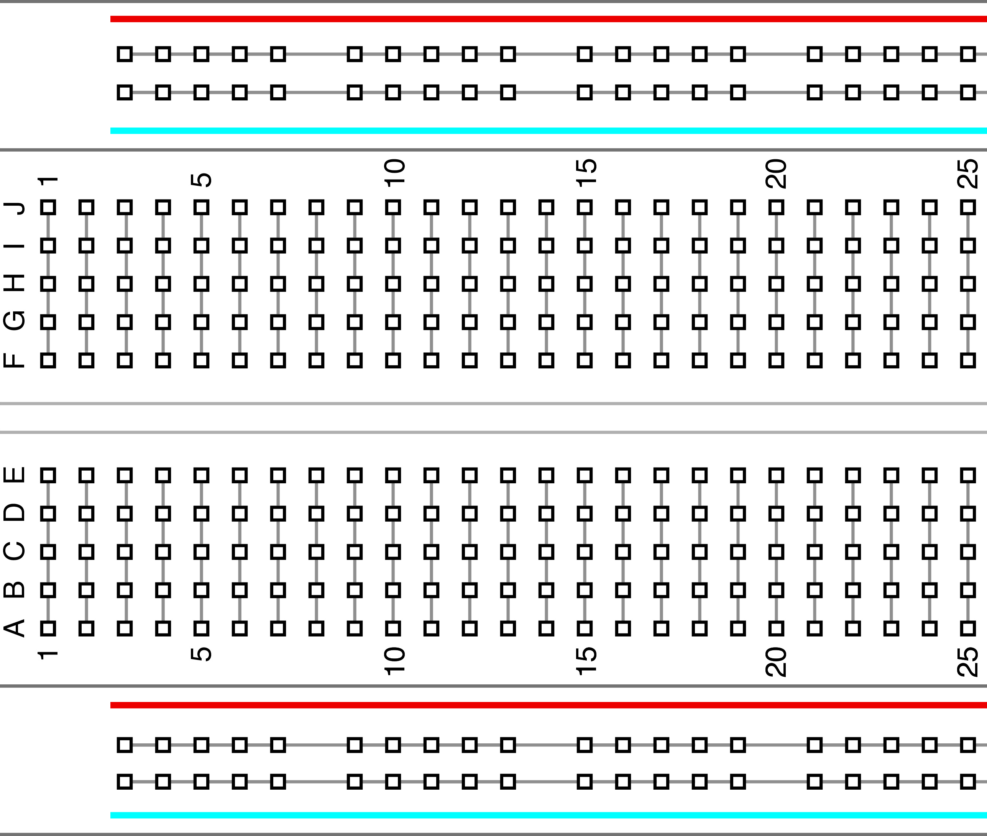
↙︎All the holes in this row are connected
↖︎All the holes in this row are connected
}
All the holes each column
are connected
}
All the holes each column
are connected
↙︎All the holes in this row are connected
↖︎All the holes in this row are connected
Notes:
Breadboard?
Just a board that has slots for easily connecting circuits and removing them. The black rows are connected as well as the blue and red columns.

Slide 16
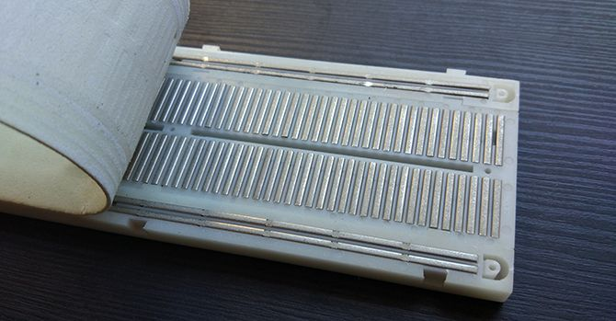
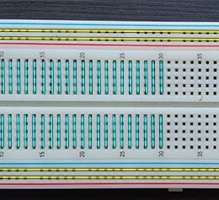
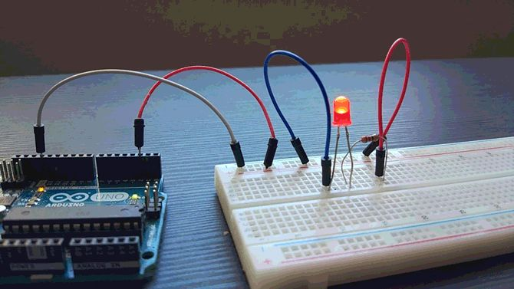

Slide 17
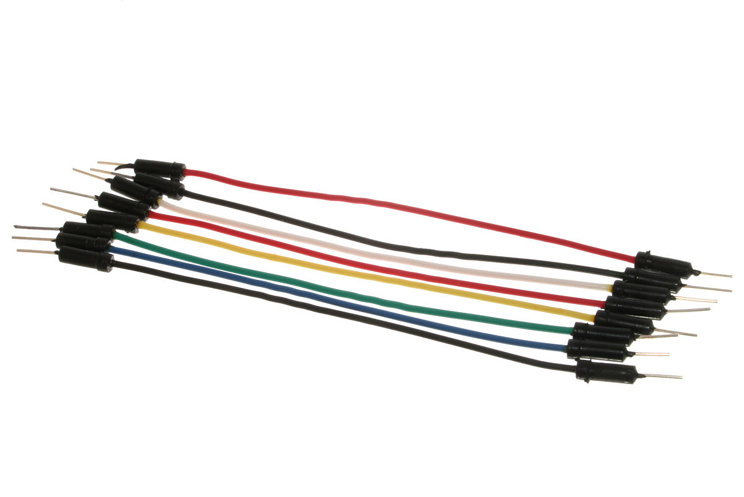
Jumper Wire

Slide 18
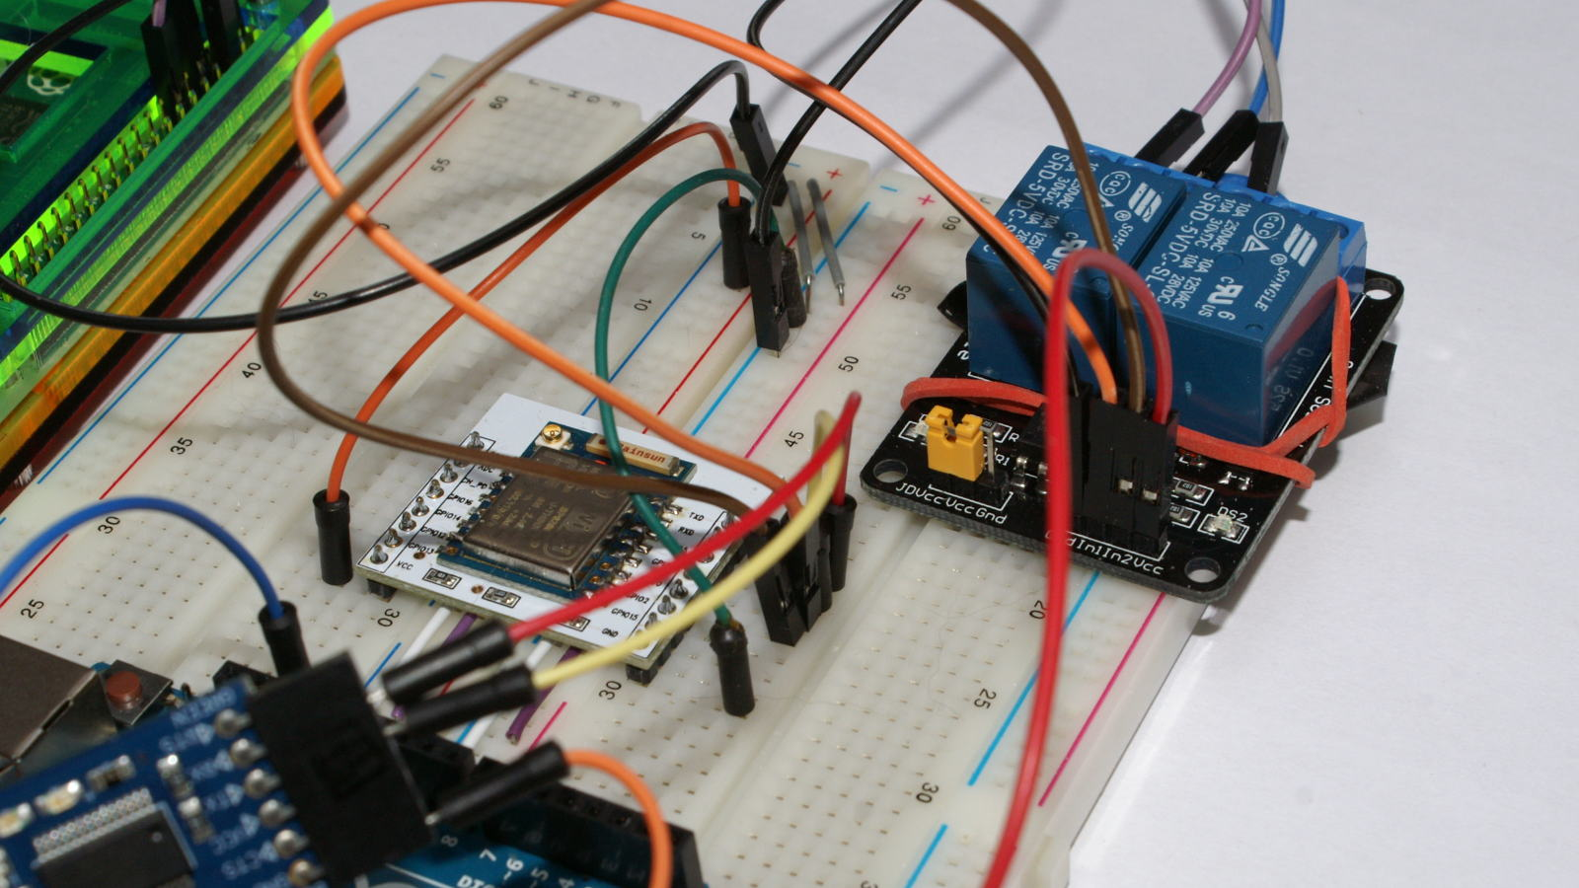
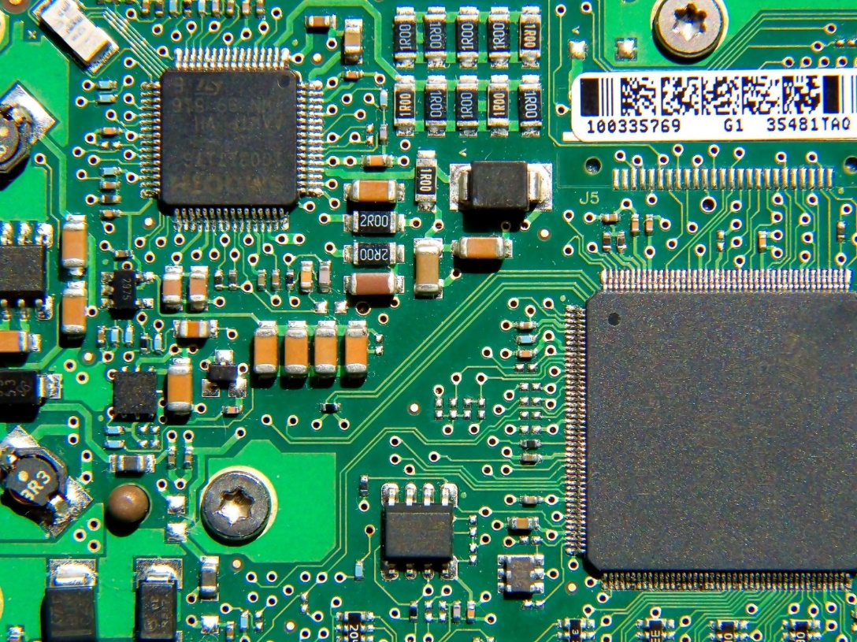
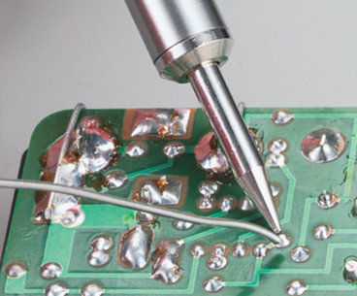
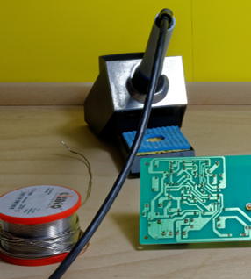
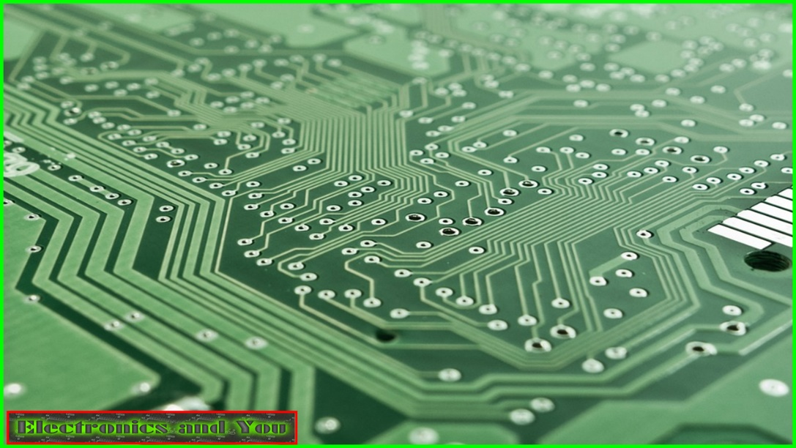
Breadboard Prototype
Printed Circuit Board
Soldered Breadboard

Slide 19
Light-Emitting Diode (LED)

Slide 20


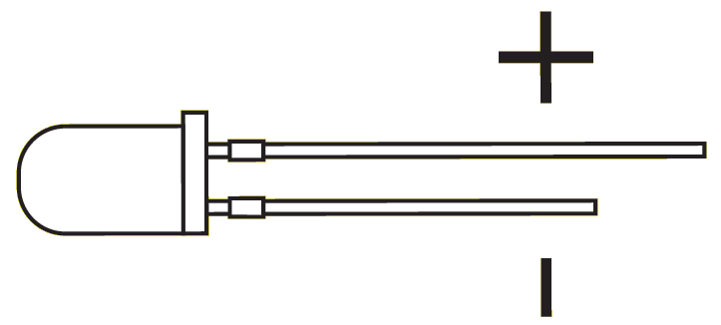

Slide 21
Resistor

Slide 22
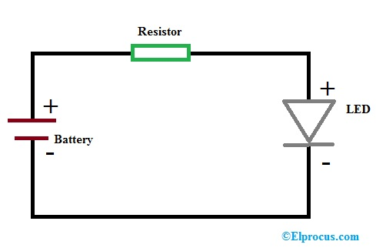
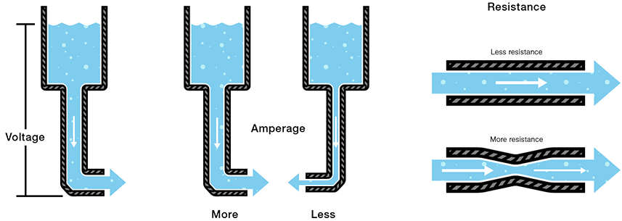
Notes:
Resistors ensure components receive the proper voltage by creating a voltage drop, and they can protect a component from voltage spikes.

Slide 23
Light Dependent Resistor (LDR)

Slide 24
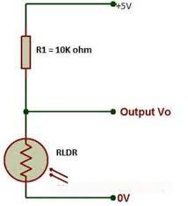
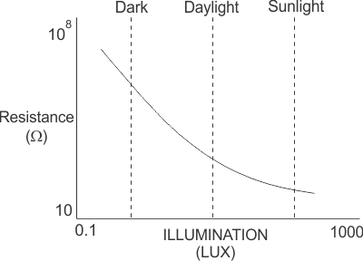

Slide 25
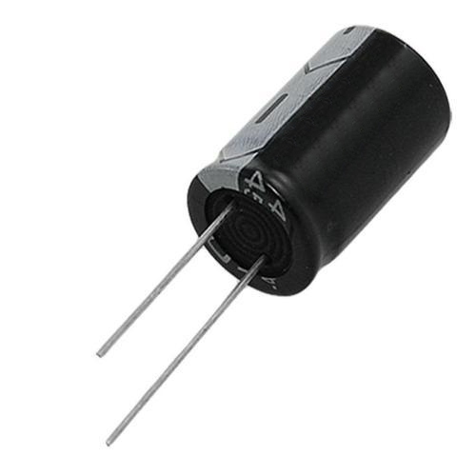
Capacitor

Slide 26
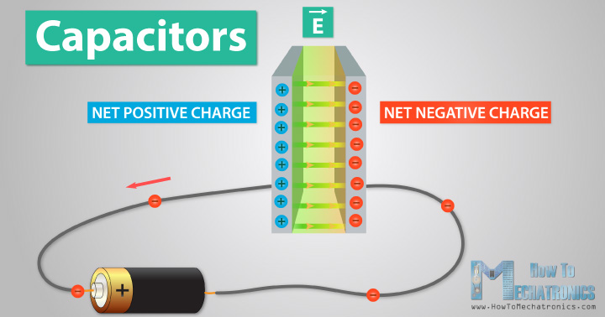

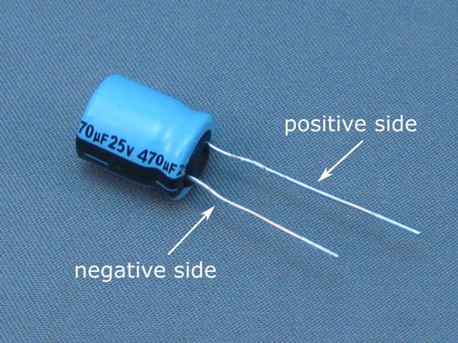

Slide 27
THE HARDWARE
Rasberry Pi (RPi)
Breadboard
Jumper Wires
Light-Emitting Diode (LED)
Resistor
Light Dependent Resistor (LDR)
Capacitor
Motion sensor (for bonus part)
-
+
-
+

Slide 28
Python Basics

Slide 29
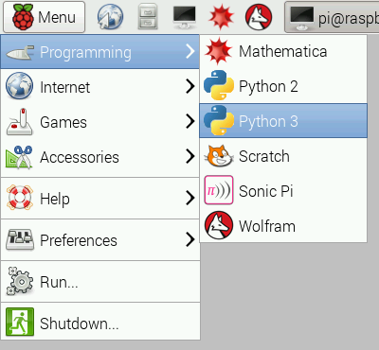
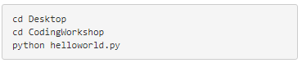
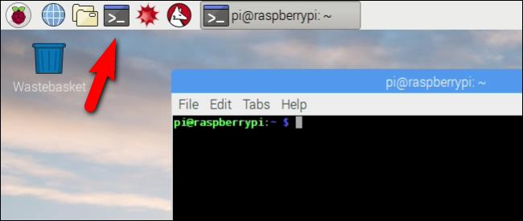
Python Programming on RPi
Notes:
Python Programming!
Write your first python program on the Pi!
Open a new Python program by opening the Python console and then clicking File> New.
Type in the below code: print(‘Hello World!’)
And save the file in the folder CodingWorkshop present on the Desktop as helloworld.py. To run this code, open the Raspberry-Pi Terminal and then run the following commands:
And there you have it, your first Python program on the Pi! :D

Slide 30

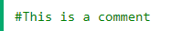
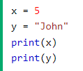
Python basics
Print statement
Comment
Variables
https://www.w3schools.com/python/trypython.asp?filename=demo_variables1

Slide 31
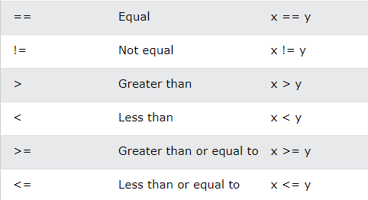
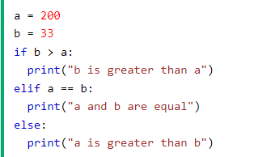
Python basics
If…Else block
https://www.w3schools.com/python/trypython.asp?filename=demo_if_else

Slide 32
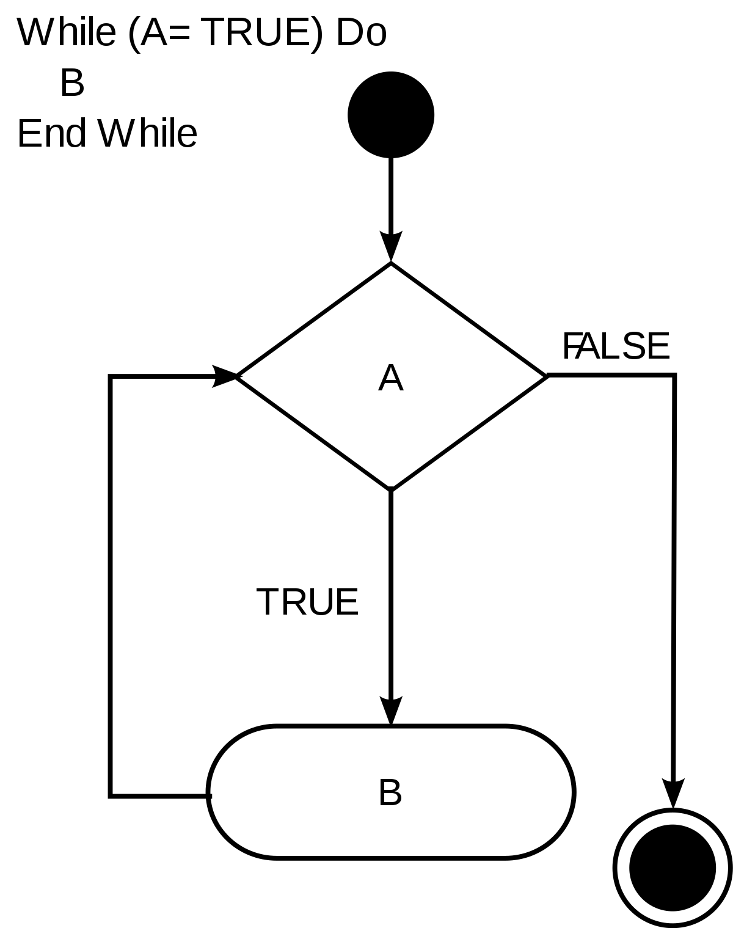
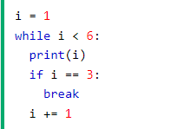
Python basics
While loop
https://www.w3schools.com/python/trypython.asp?filename=demo_while_break

Slide 33
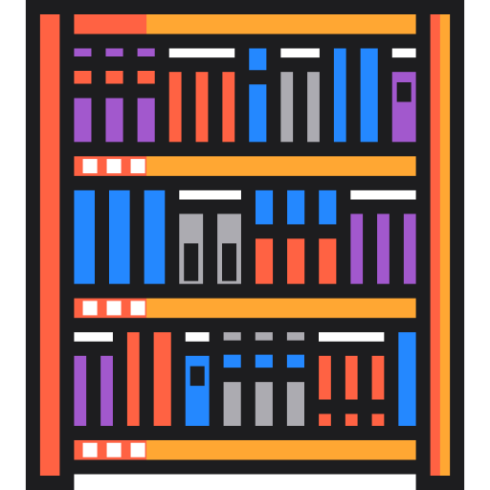
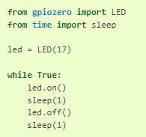
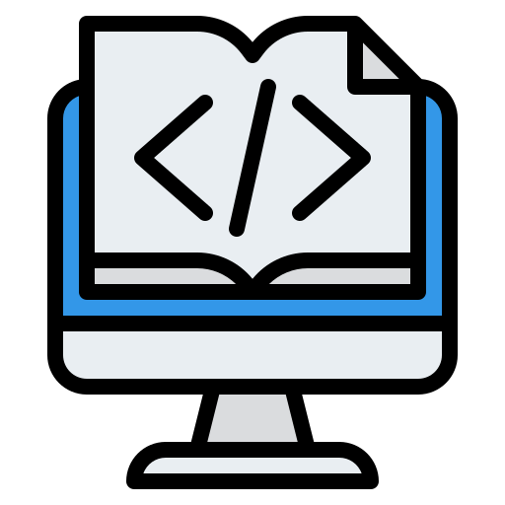
Python basics
Library imports
Library/Module
Imports
https://gpiozero.readthedocs.io/en/stable/api_input.html
Your code program

